Slide 1
Fun with LEDs
Prof. Ken Connor
RPI

Slide 2
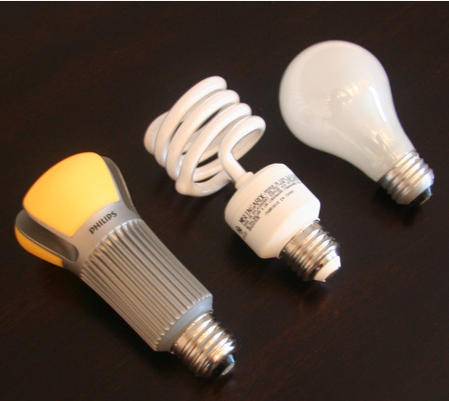
LED vs CFL vs Incandescent

Slide 3
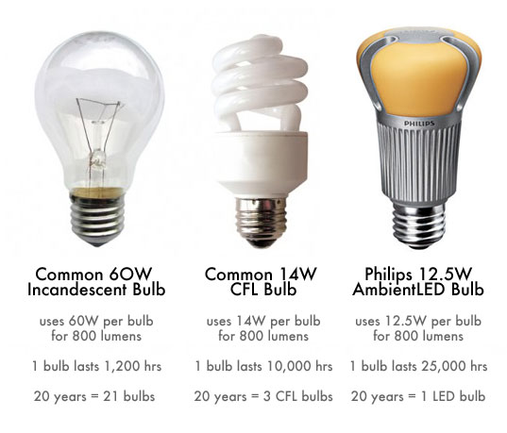
Comparison

Slide 4
What is a Lumen?
Lumens measure how much light you are getting from a bulb. More Lumens means you see a brighter light; fewer Lumens means you see a dimmer light.
Rules of Thumb
100W Incandescent: 1600 Lumens
75W Incandescent: 1100 Lumens
60W Incandescent: 800 Lumens
40W Incandescent: 450 Lumens

Slide 5
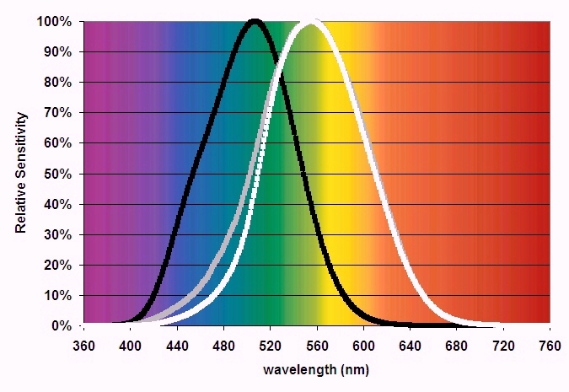
Human Light Sensitivity

Slide 6
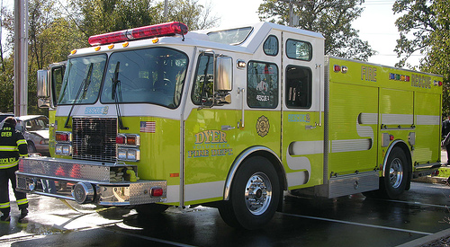
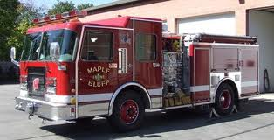
Fire Truck Color?
Lime Green vs. Red

Slide 7
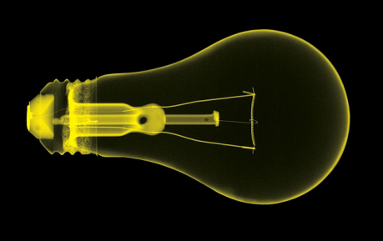
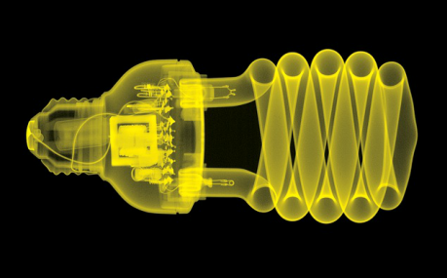
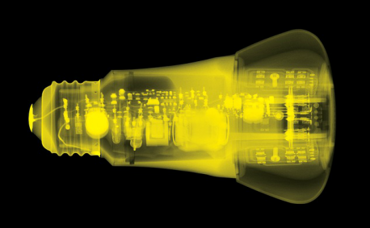
What is Inside?

Slide 8
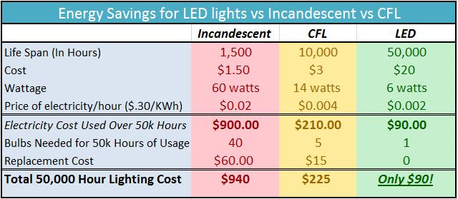
Energy Savings

Slide 9
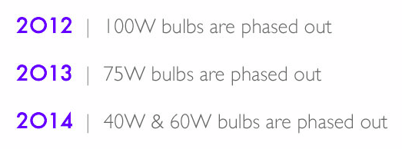
Incandescent Phase Out

Slide 10
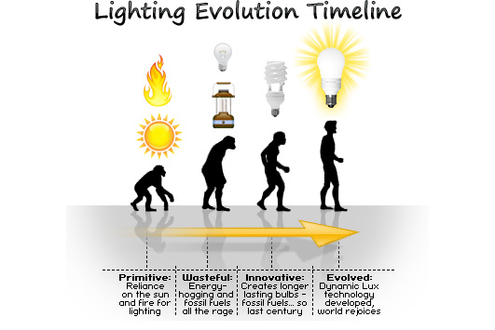

Slide 11
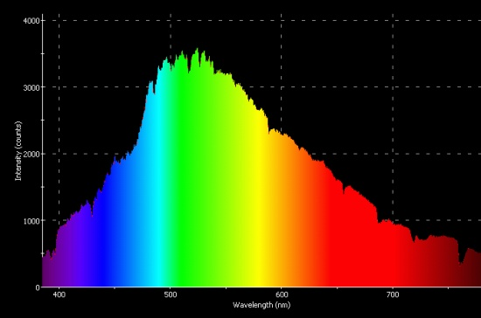
Sunlight

Slide 12
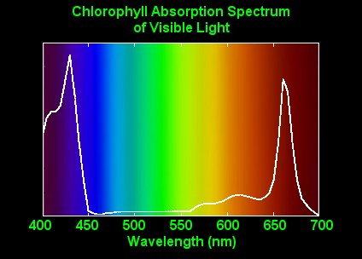
Light Used by Plants

Slide 13
Some References
X-Ray Photos
Smart Lighting ERC

